Slide 1
AVEVA Work Tasks
Advanced workflow management and mobile solution for the digital transformation of industrial work processes and standard operating procedures

Slide 2
AVEVA Work Tasks at a glance

Slide 3

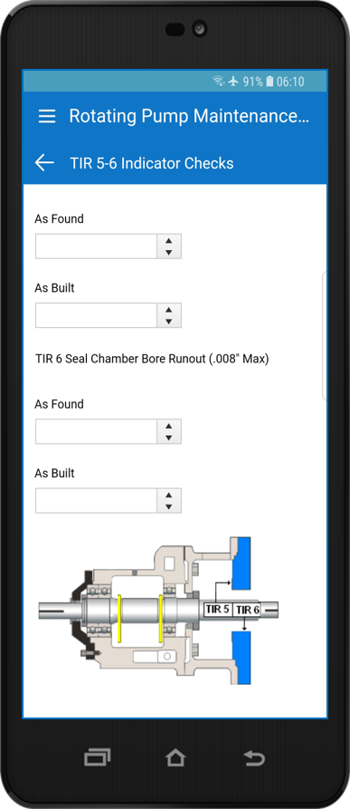
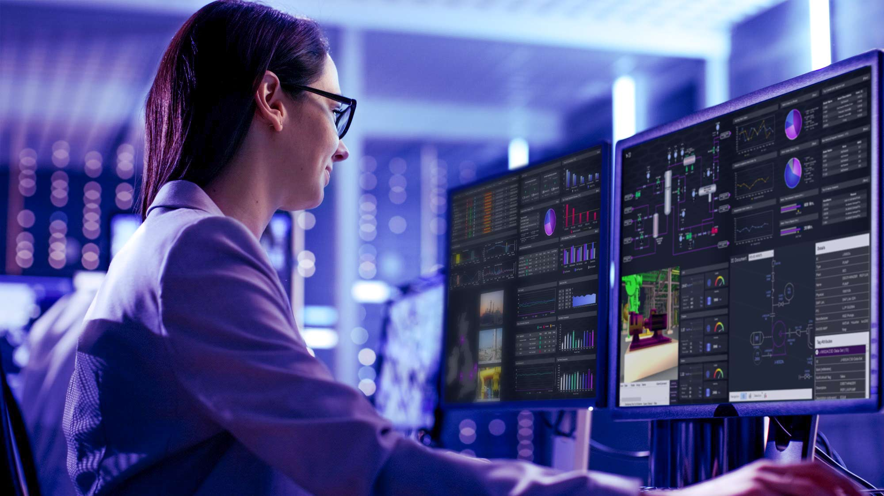
AVEVA Work Tasks
What is it?
A digital framework to model, execute, monitor and analyse industrial work processes and standard operating procedures for:
  Replacing inefficient Paperwork with a digital user experience and workflow automation
  Empowering Workers to execute work and data collection tasks more efficient, collaborative and secure
  Connecting Workers with orchestrated access to assigned tasks and related context information
  Reducing noncompliance Risks and human error through procedural enforcement, data entry validation for triggering corrective actions and with a full audit trail
  Continuously Improving processes and procedures with notifications and visibility into work execution issues and performance KPI’s

Slide 4
Industrial Standard Operating Procedure Challenges

Slide 5
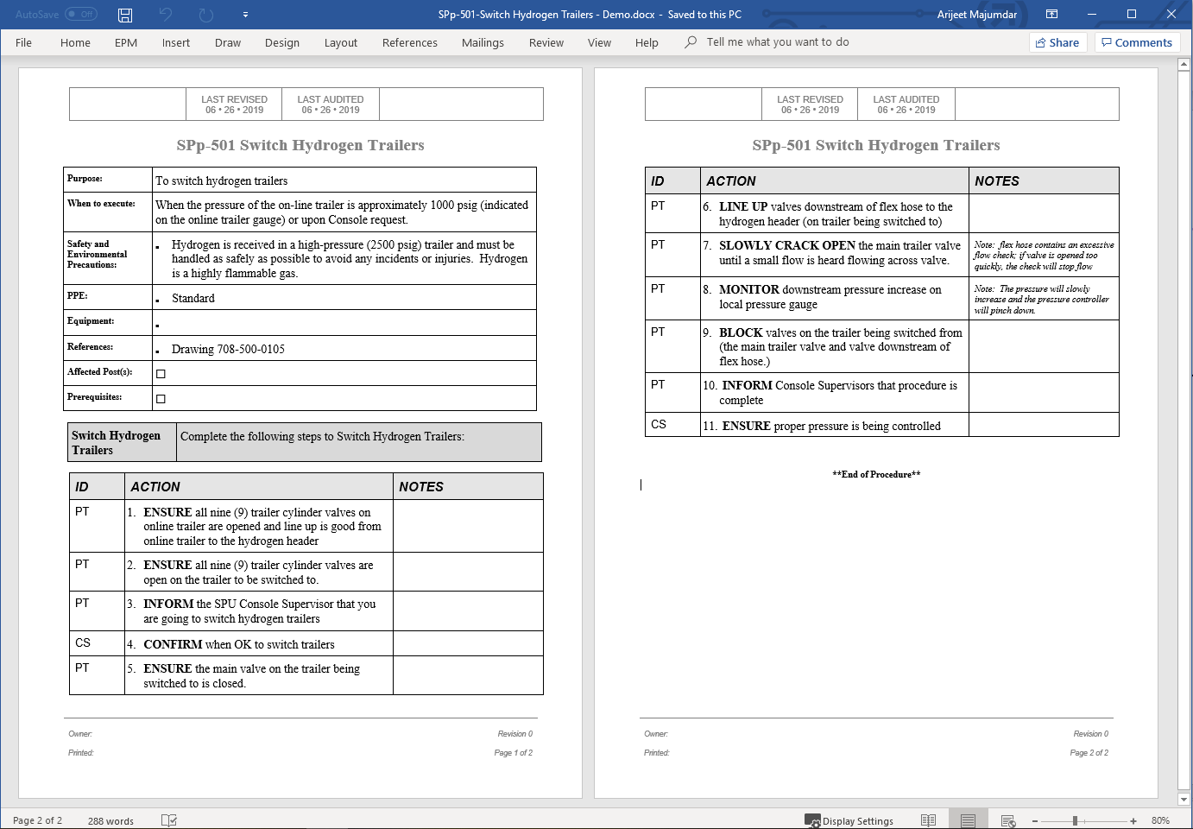
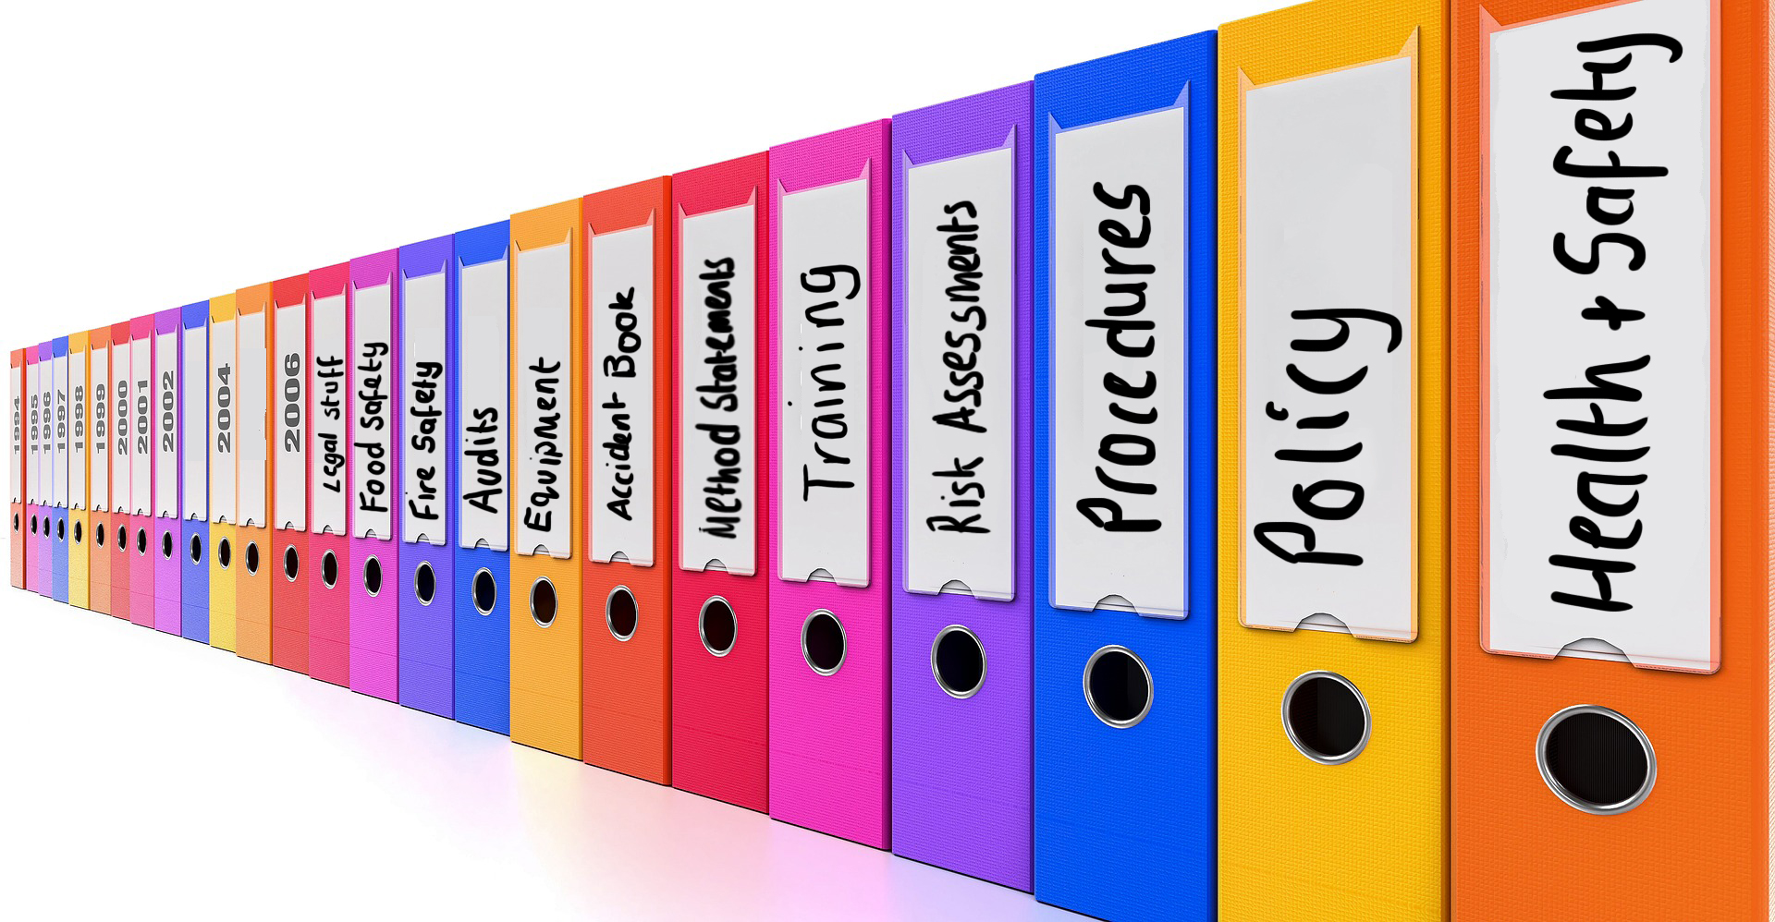
Standard Operating Procedures
Often authored in Microsoft Word and printed out on Paper for Execution today
About Procedures:
Commonplace across all industries
Vary in complexity, e.g.
  Safety, Environment & Health
  Checklists
  Startup and Shutdown
  Turnaround
  Routine Work Processes

Slide 6
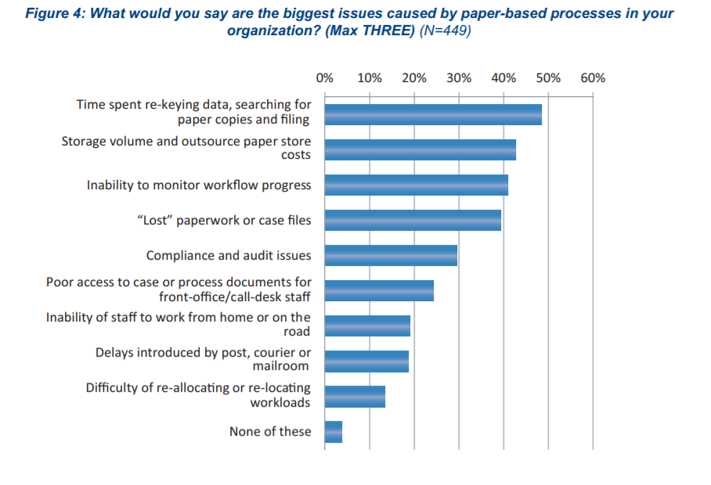
The biggest issues caused by paper-based processes
Source: Winning the Paper Wars – AIIM research 2013
https://www.aiim.org/pdfdocuments/IW-Paper-Wars-2013.pdf

Slide 7
Customer Challenges - Industrial Operating Procedures
Cost and inefficiency of procedure document management and governance
The risk of human error, data entry mistakes, records lost or misfiled
No easy access to data for problem solving, compliance audits & continuous improvement
The digital enablement expectations of the next generation worker
PAPER FORMS & WORKFLOWS
DUPLICATE DATA ENTRY
VISIBILITY & INSIGHTS
Brownfield organization have 1,000’s of paper forms and manual workflows for safety, operations and maintenance activities. This presents significant issues in governance, completeness, storage and retrieval
When activity reports and data collected at the asset or process must be rekeyed into supporting systems, leading to lost productivity, errors and omissions.
Data from control and business systems is extracted, imported, manipulated and distributed via Excel or hard coded integrations, resulting in delays, manual steps, and missed opportunities for optimization & continuous improvement

Slide 8
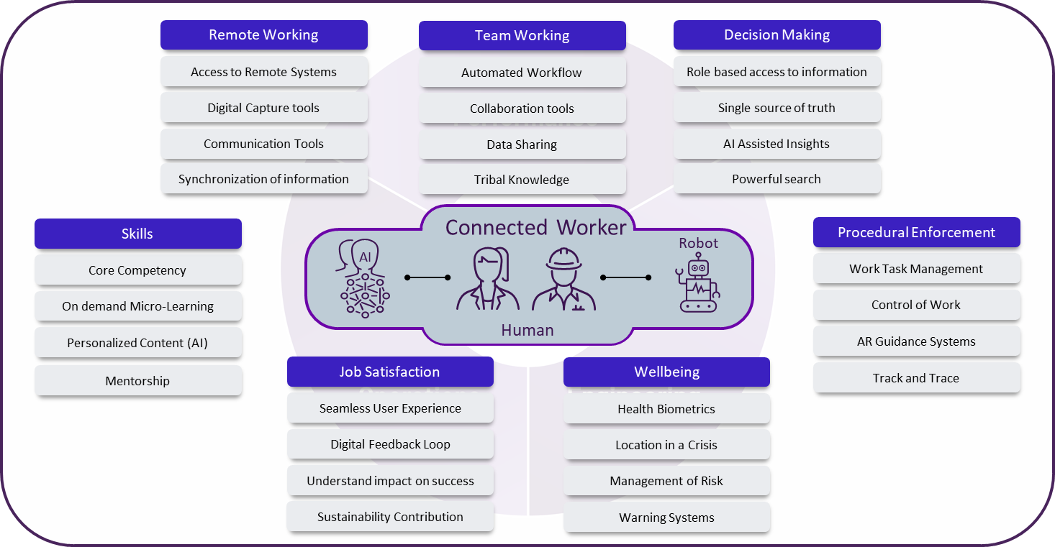
Technology is revolutionizing how work is performed
The Connected Worker
MOBILITY
Mobility brings actionable data and work tasks together at the point where work happens
COLLABORATION
Sharing knowledge and facilitating working together across organizations within the plant and remotely, to improve productivity
EMPOWERMENT
Information access and decision making support through BI/OI, AI, AR/VR accelerates mastery of work tasks and problem solving skills for a new generation of workers

Slide 9

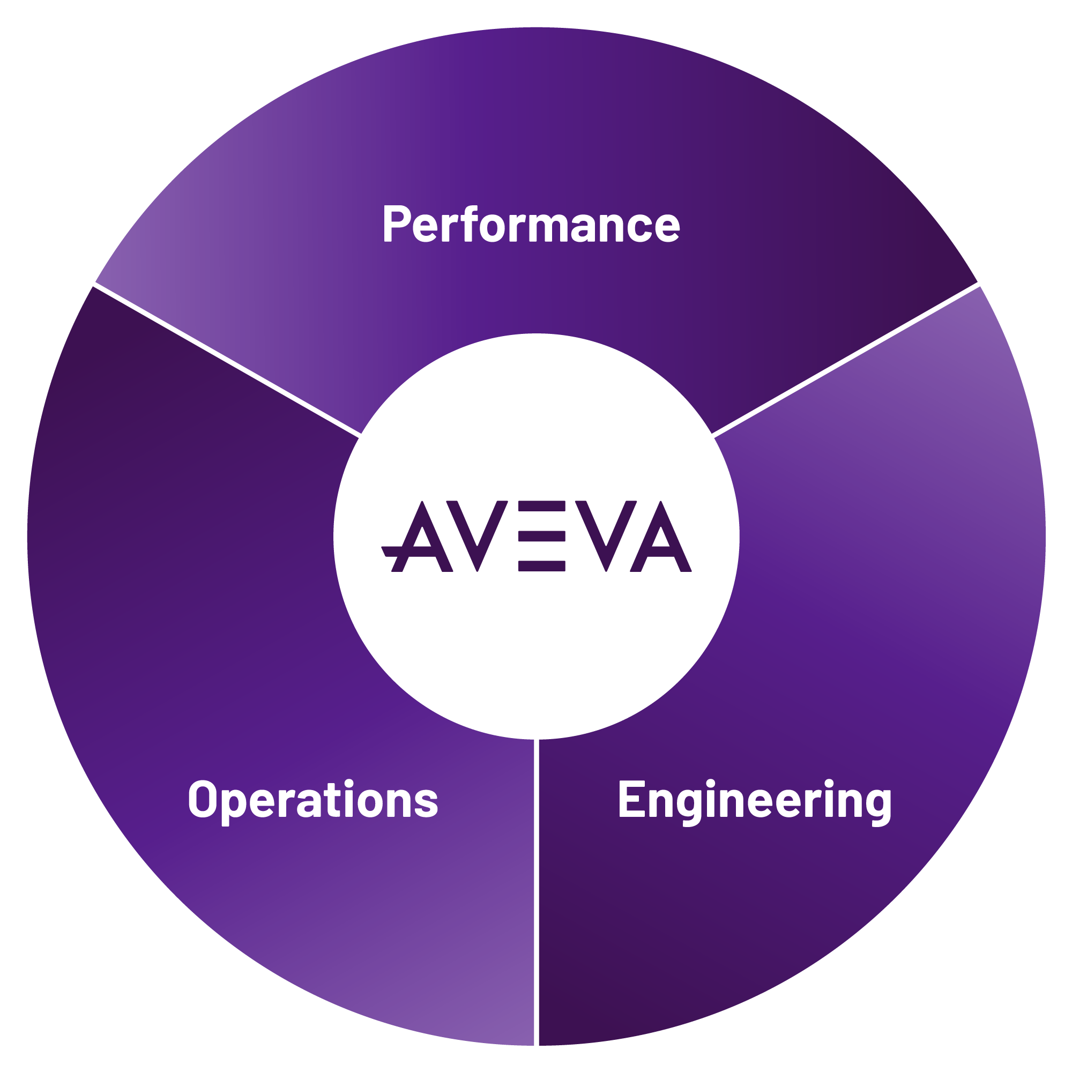





The new business and technology imperatives
Run agile and continuously optimized supply chains
Connected Worker
Digital Twin
Operate critical assets reliably and safely with reduced manual supervision
Artificial
Intelligence
Re-plan CapEx and drive highest levels of engineering efficiency
Cloud
Big Data
Provide remote ‘digital’ teams rich information and decision support to collaborate and work efficiently
Industrial IoT/Edge
Notes:
Four key areas have emerged as business imperatives for the new normal.
As capital investments reduce, companies need to re-evaluate projects for viability and to reduce total installed cost. This will require operators and contractors to revisit traditional work processes and information exchange, to enable an entirely new way of engineering.
With remote teams requiring better context to supervise operations, collaborate and make decisions, there is a heightened need for better visualization and contextual analysis of operating information across the enterprise.
As operations start to become increasingly autonomous, ensuring the reliability and safe operation of critical assets with minimal supervision becomes vital. Personnel on the shop floor and in the field, will increasingly need work task enablers and aids, as deep operating expertise becomes scarce.
And finally, in an environment of heightened volatility and unpredictability on both the supply and demand side, companies will need to drive high levels of agility and responsiveness across value chains to minimize value leaks, optimize production and maximize profit opportunities.
However, addressing these requirements does not mean a fresh start.
In the industrial context, much of the foundational work has already been done, within the broad theme of digital transformation.
First, Industrial IOT has created the opportunity to access unprecedented amounts of data from connected assets,
Secondly, with improvements in connectivity and data security, historical barriers have started to lower and the advantages of cloud deployments, have started to get realized, and
Finally, the management of change within organizations, often underestimated in its impact on technology adoption and scaling, started in a formal sense as companies started to drive digital transformation initiatives.
The progress made in these key areas has created the foundation for the industrial sector to address the imperatives of the new normal.

Slide 10
How does AVEVA help address these challenges?

Slide 11
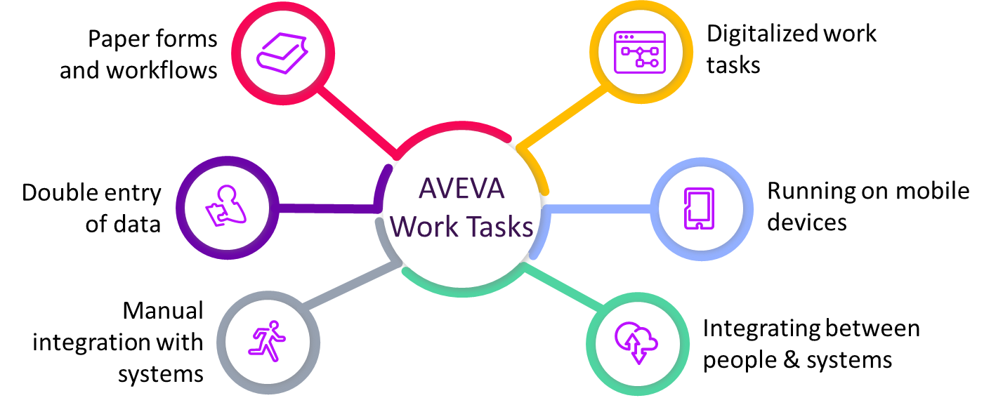
AVEVA™ Work Tasks
Advanced work tasks management for the digital transformation of standard operating procedures

Slide 12
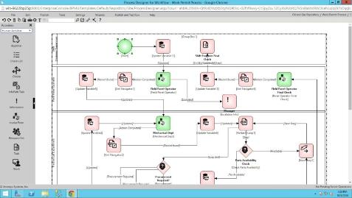

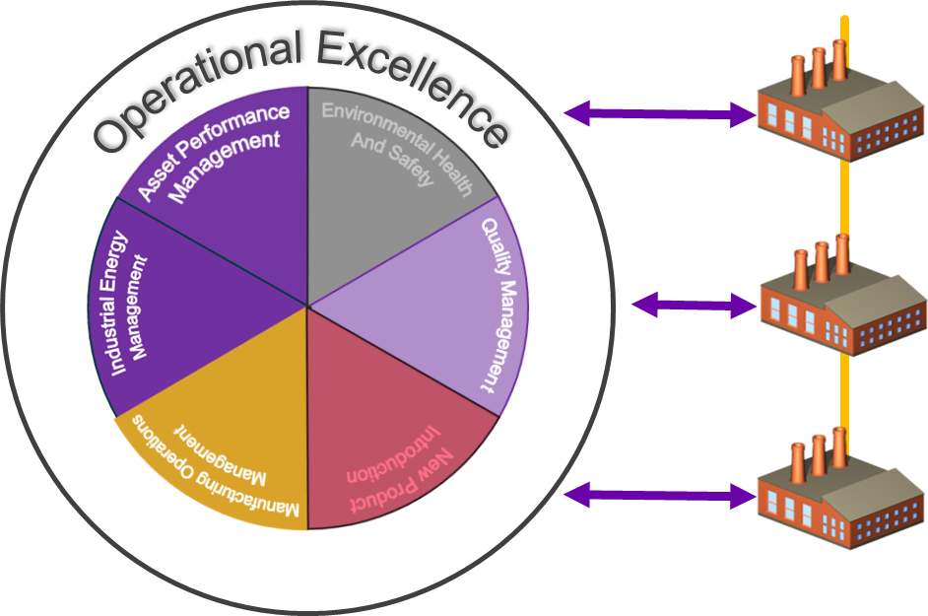
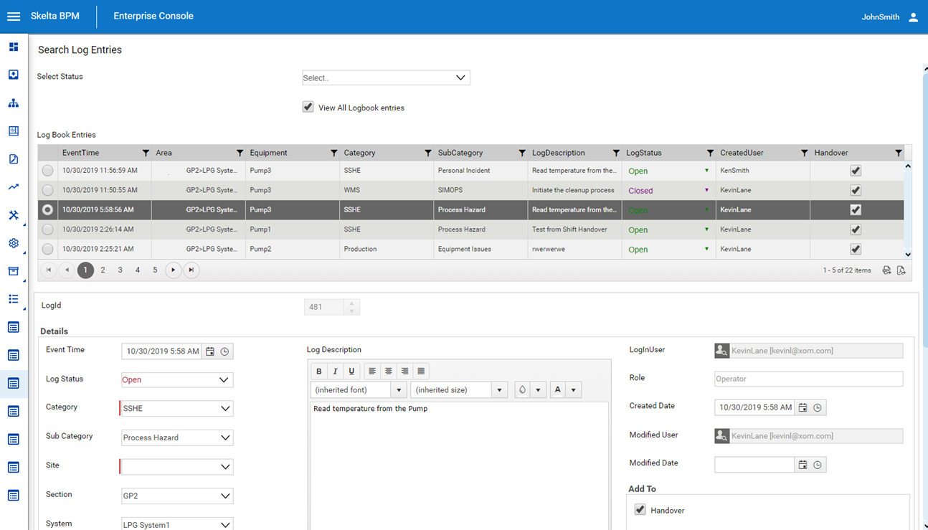



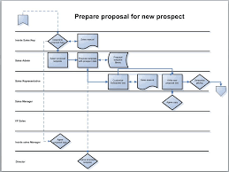
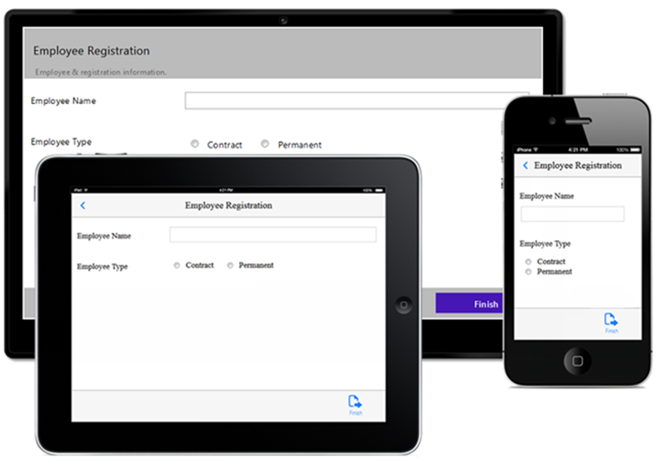
A Unique Transformation Experience
Advanced work tasks management for the digital transformation of standard operating procedures
Procedure Model
Digital Forms authoring
Digital User Experience and Data Mgt
SOP
Definitions
Compliance
& Safety
Best
Practices
1
2
3
DIGITIZE
STANDARDIZE
IMPROVE
Capture standard operating procedures and digitize them using low code technology and transform how work is done
Consistent execution of SOP’s and collection of compliance and safety data across the enterprise
Continuous improvement of procedures based on rich data collection with governed change management
© 2020 AVEVA Group plc and its subsidiaries. All rights reserved.

Slide 13
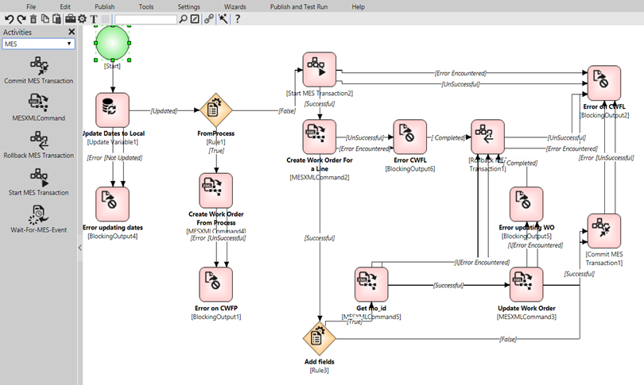
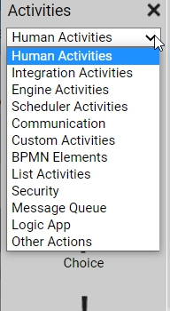
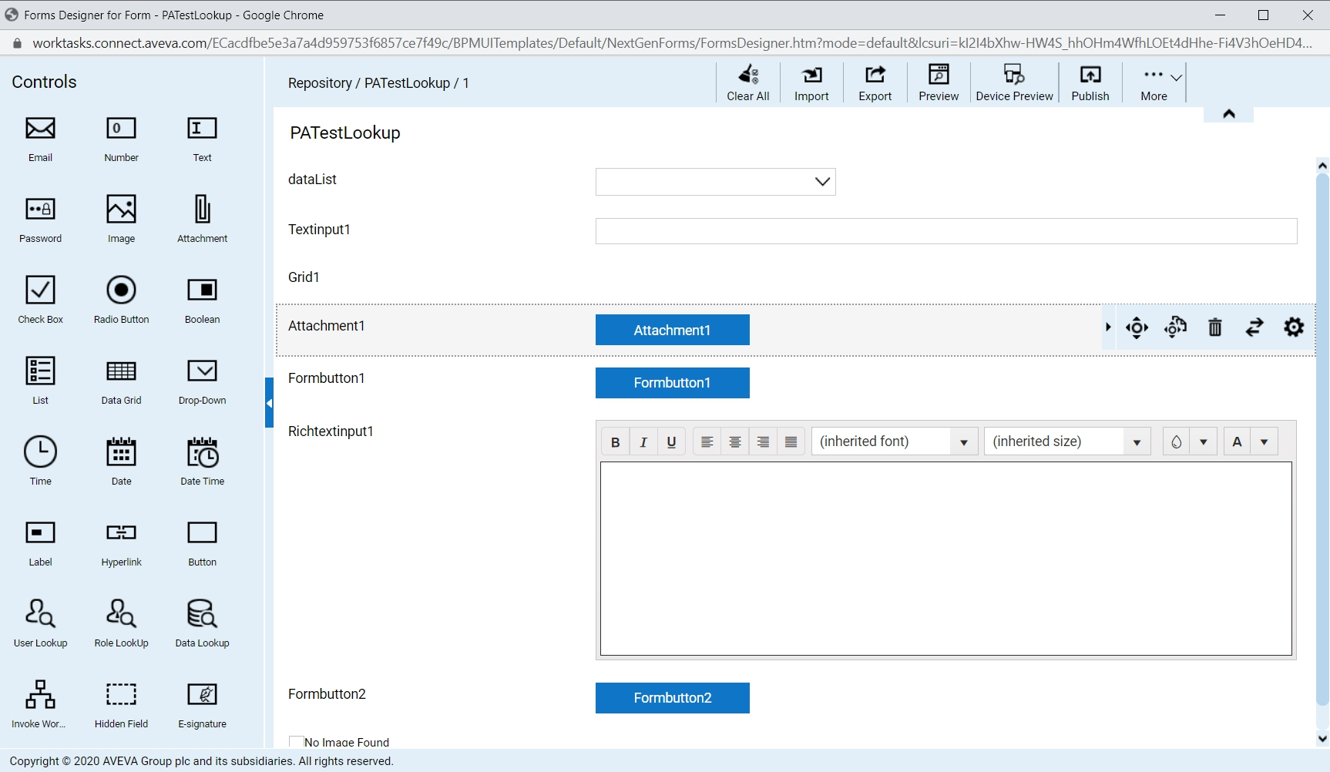
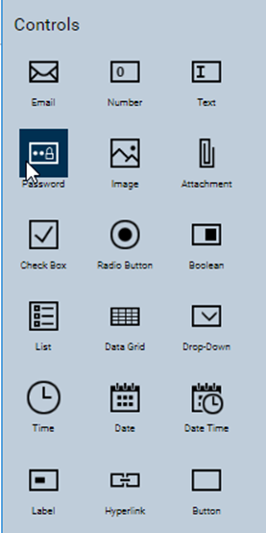
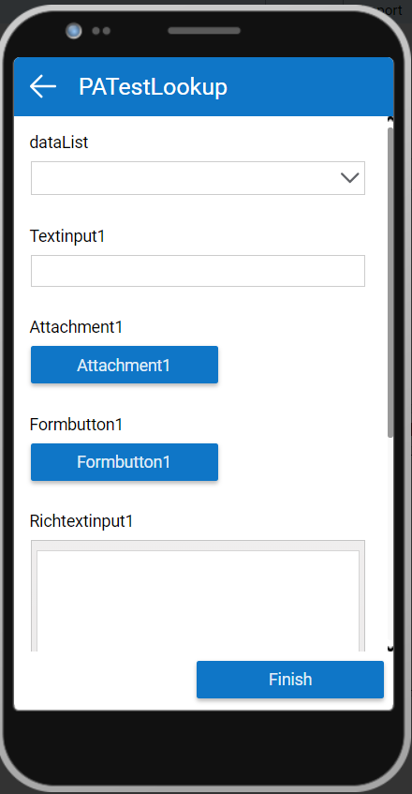
AVEVA Work Tasks - Key Capabilities
A Framework for Designing, Executing and Sustaining Industrial Work Processes & Procedures
Workflows
Forms
Mobile App
Intuitive, visual workflow modeling environment and automation engine
Defining the sequence of activities to be performed across people, data and systems to accomplish a work task.
User interfaces are modeled in a simple, easy to use forms layout environment with smart controls
Adaptive layout and responsive design supports browsers and mobile devices
Native mobile app for executing work tasks and data collection procedures
Assigned work tasks are downloaded on to the mobile device to be executed on and offline
  AVEVA Work Tasks Pro,
  a native Mobile device App available for iOS, Android and Windows

Slide 14
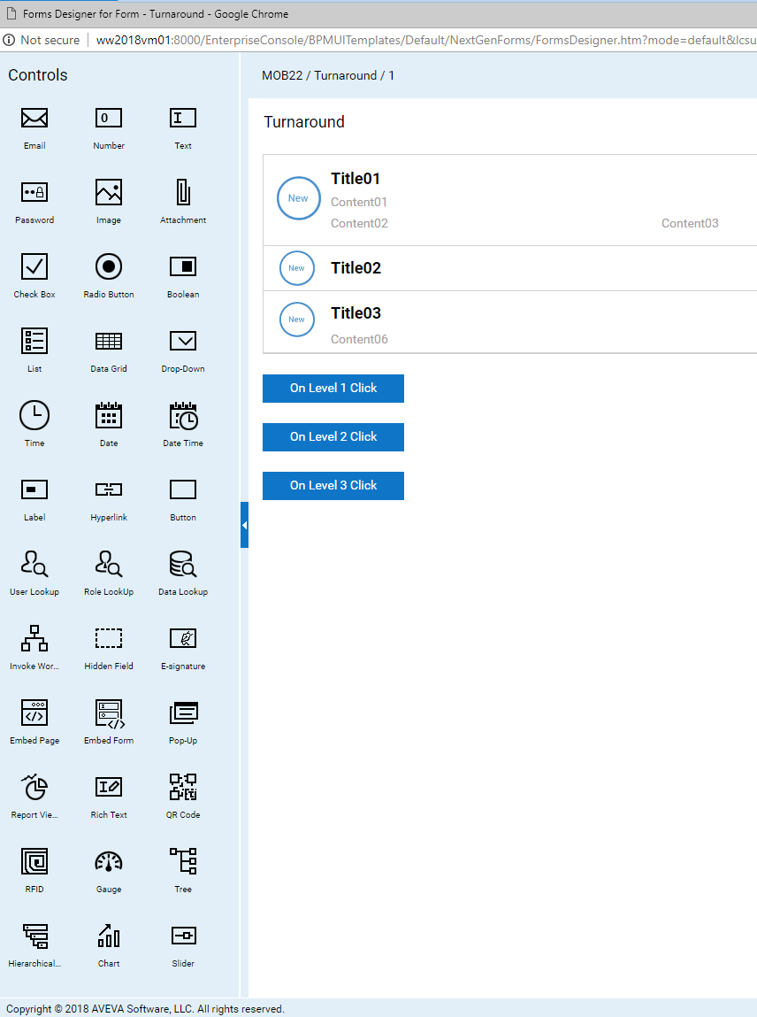
Configurable User Interface
Forms Designer
Model simple or complex HTML5 web forms to visualize and collect data
A patented low code forms design tool to create form layouts with drag and drop smart controls
Unified user experience across all devices with an adaptive layout and responsive design
Scripting for data entry validation or more advanced user interface logic
Manage versioning and security of forms

Slide 15
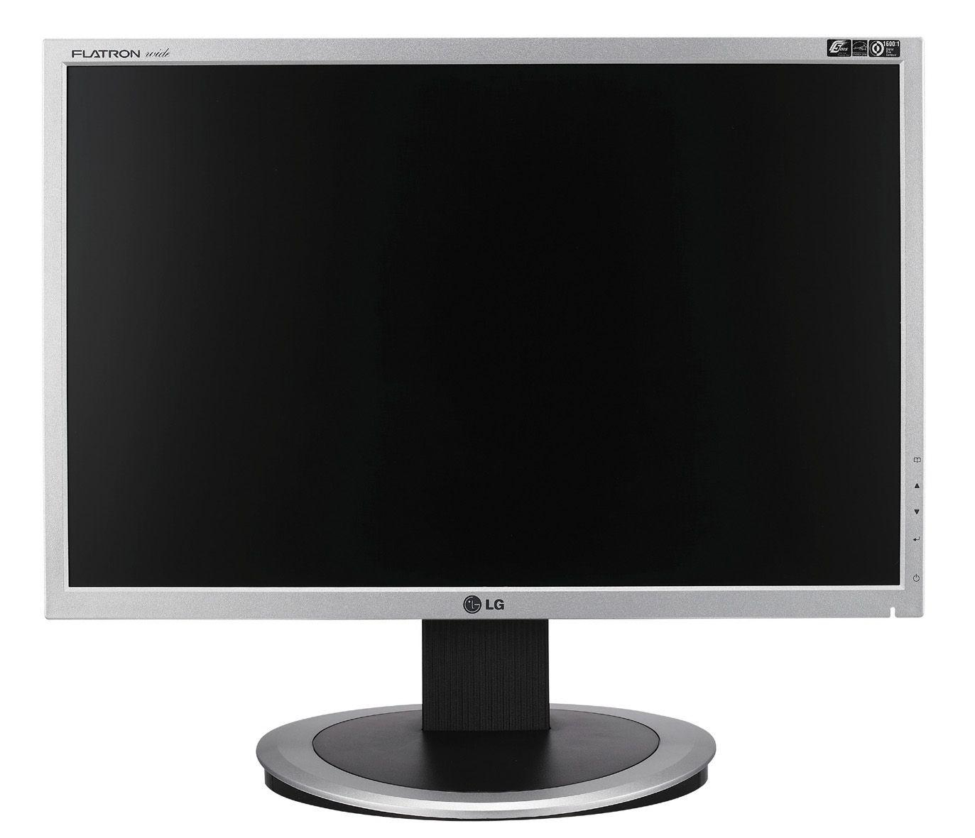
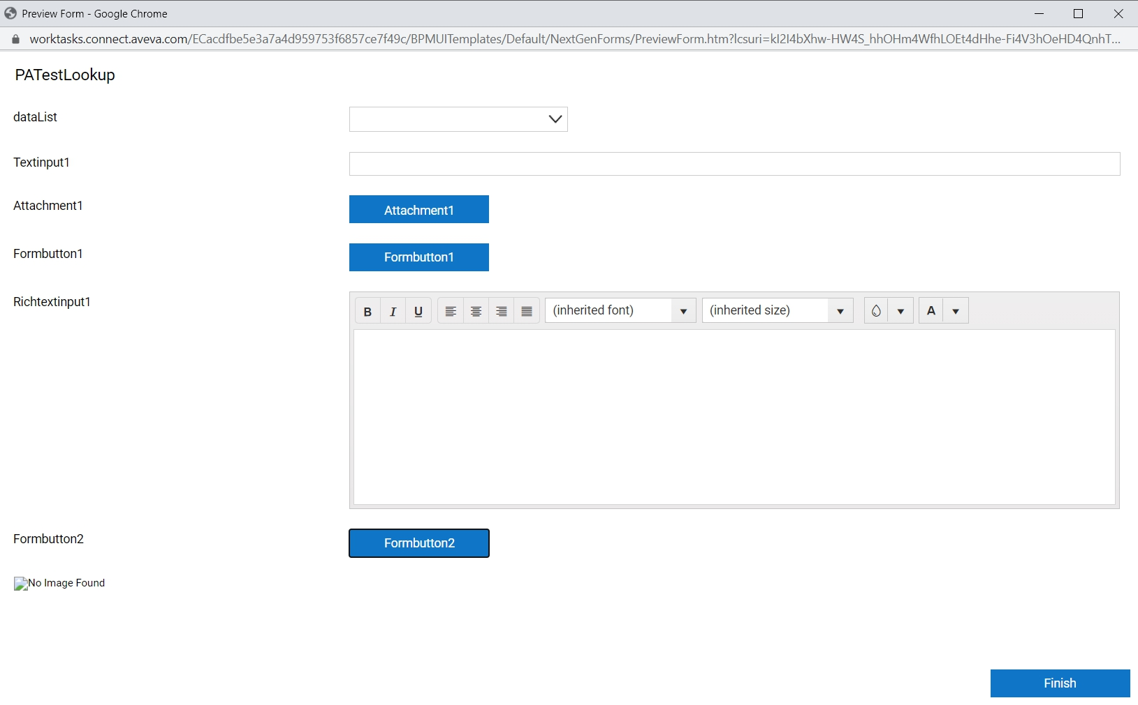
Responsive Layout
Forms Designer
Responsive layout adoption
for Workstation & Mobile Devices

Slide 16
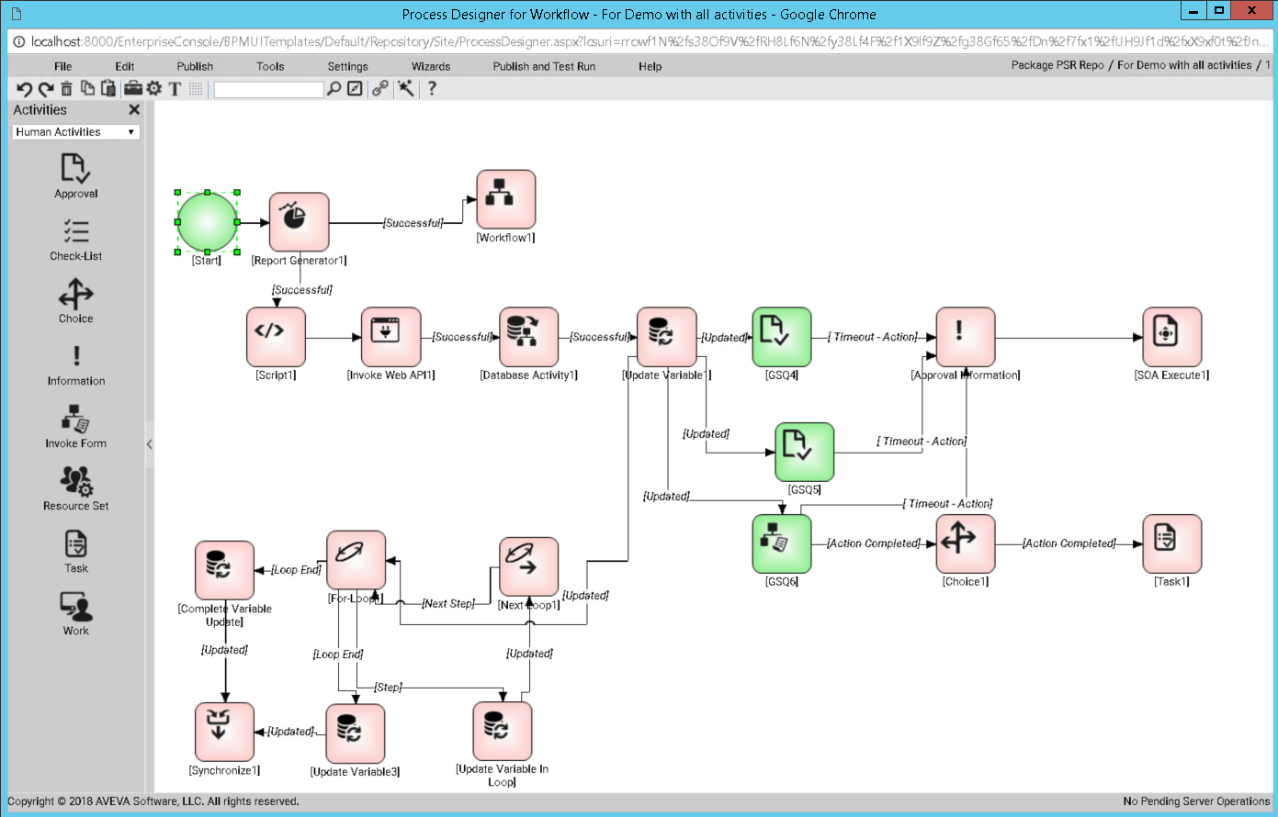
Workflow Modelling
Process Designer
Intuitive, visual modeling environment
Many out-of-the-box configurable workflow activities for human interaction, and integration with systems and data sources
Supports complex branching
Supports complex decision trees

Slide 17

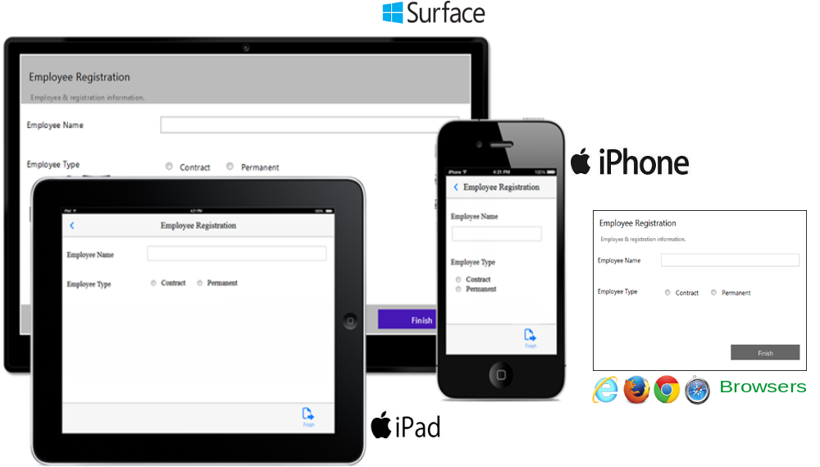
Work Tasks Execution
Efficient, Consistent and Documented
Workflows can be initiated manually
or automatically
Sophisticated calendar management
Sophisticated task escalation
End-users interact with AVEVA Work Tasks via:
  Browsers,
  The native Mobile device App
  (for iOS, Android and Windows)

Slide 18
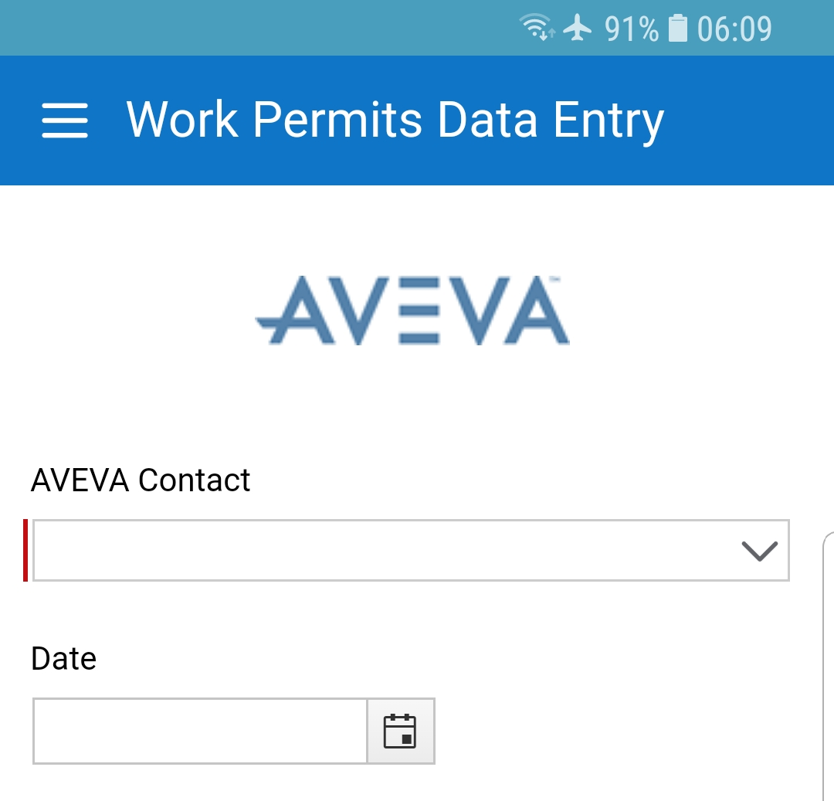
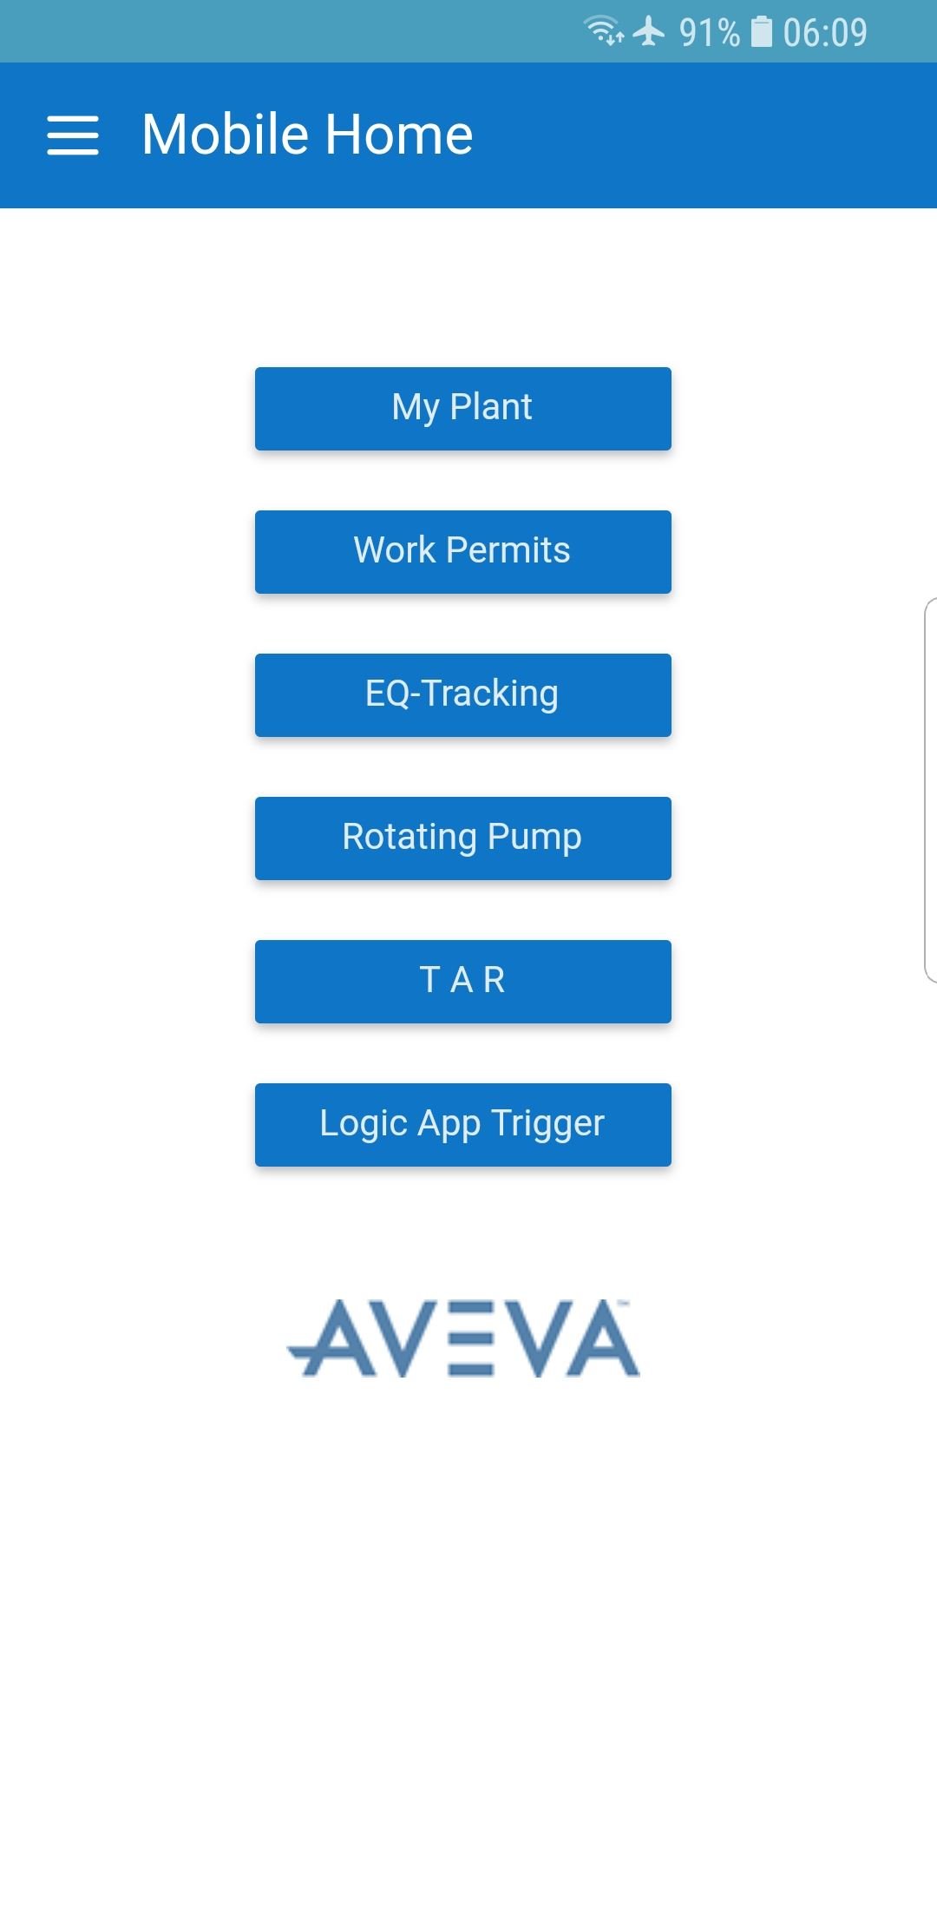
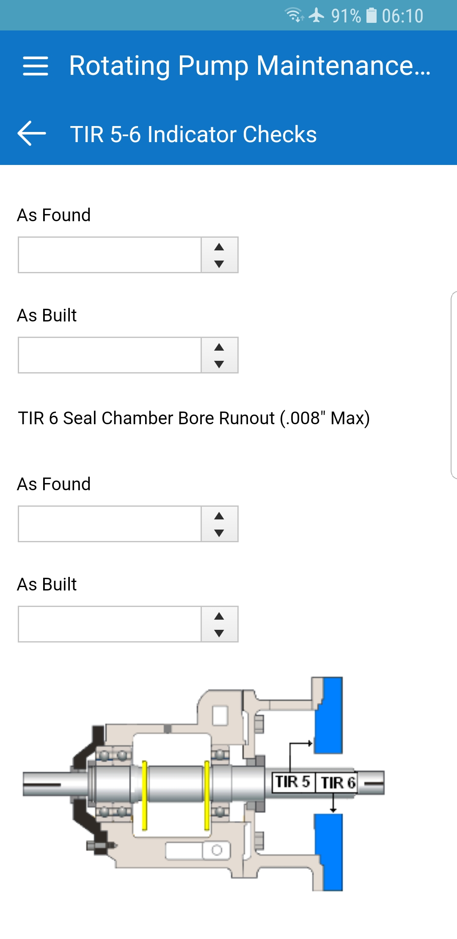

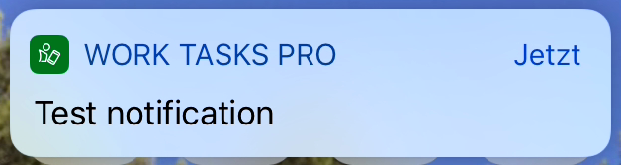

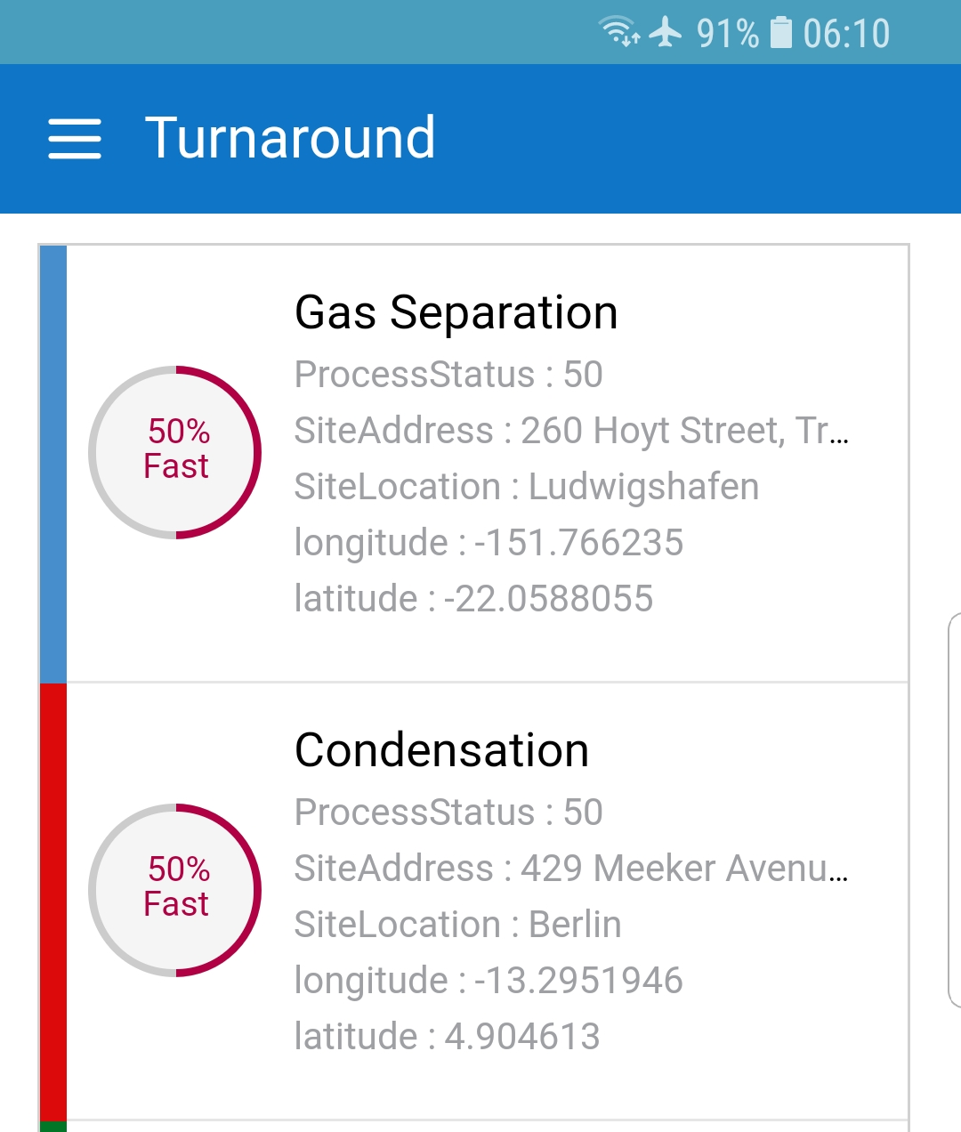

Work Tasks Pro App for Mobile Devices
Digitized
Documents
Data Collection
Mobile
Notifications
Checklists
Turnaround
Compliance

Slide 19
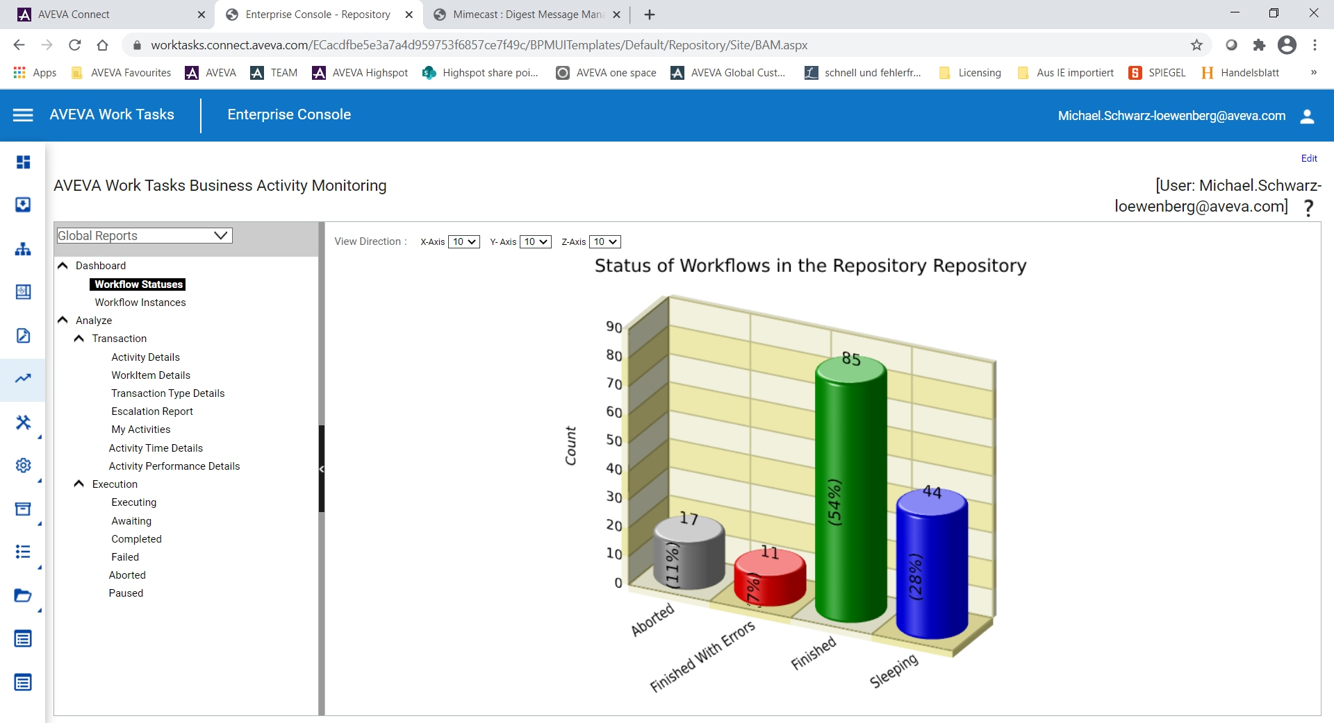
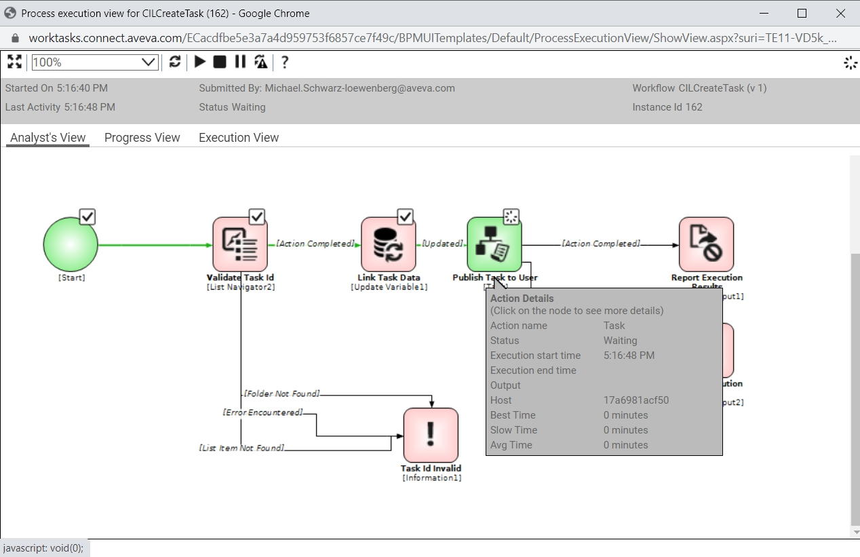
Continuous Improvement
Work Tasks monitoring and performance analyses
A dashboard which highlights workflow status and workflow instances
Customizable Key Performance Indicators (KPIs)
Performance Analysis
Proactive alerts of Process Exceptions and KPIs

Slide 20
Enabling Digital Work Procedures
Keith
A Framework for Digitizing, Executing and Sustaining Industrial Work Processes & Procedures
CHANGE HOW WORK IS DONE ACROSS
THE ENTERPRISE
AVEVA Work Tasks offers a platform to transform work procedures with a digital user experience on desktop and mobile devices:
  Digitalize EHS inspections, quality, inventory, asset, maintenance and routine operational procedures
  Supports operating rhythms in the plant with operator log book, shift handover and alarm escalation and notifications
  Reduces errors and omissions, ensures data integrity and eliminates rekeying of data
  Integration with AVEVA applications, external data and systems allows for mobile and connected worker solutions
Digitize Execution & Governance
Agility, Continuity & Sustainability
Increase Productivity
Ensure EHS & Sustainability

Slide 21
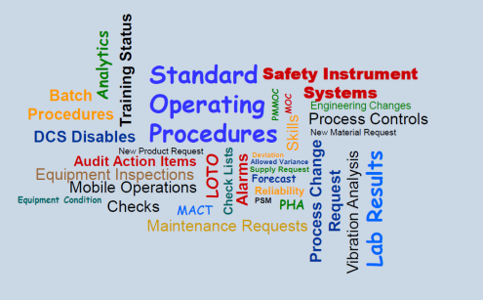
AVEVA™ Work Tasks - Benefits
Framework for Designing and Executing Digital Industrial Work Processes & Procedures
Drives work efficiency by eliminating paperwork and digitizing operational work processes/standard operating procedures.
Systematically orchestrates work tasks and collaboration across people and systems (AVEVA and third party).
Secures safety and compliance by enforcing consistent and compliant procedure execution and data collection.
Empowers the connected and mobile worker with procedural guidance and information access.
Provides visibility into work process performance and issues for continuous improvement
Allows to captures the knowledge of an aging workforce and to standardize operational best practices across the business to empower the next generation of workers.

Slide 22
AVEVA Work Tasks
Customer Success Stories

Slide 23
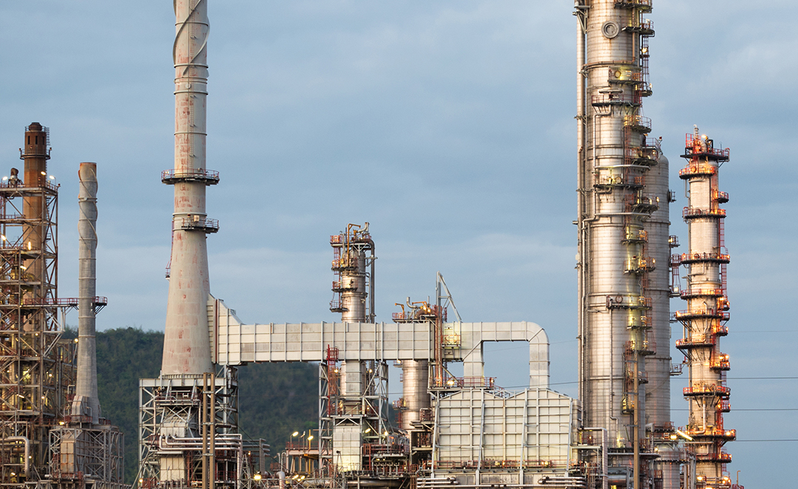
Ascend Performance Materials
  Pensacola, Florida
Goals
  Eliminate manual input of data
  Visualize the overall manufacturing process
  Accurately record all relevant manufacturing data
Challenges
  The business was not tracking data to ensure production efficiency and product quality
  There was a lack of process consistency throughout the plants
Results
  The company achieved a savings of $500,000 in utilities and materials costs
  More than $1 million in savings was achieved in maintenance costs
  Avoided potential plant shutdowns which equates to a savings of $2 million
  Overall technology implementation took only 90 days
Industry: Chemicals
Products: AVEVA Mobile Operator Rounds| AVEVA Intelligence | AVEVA Work Tasks
  “We’ve found a great benefit in being able to maintain a core user group and consistency throughout the plants.”
Terry Unruh, PE Production and Maintenance, Ascend
Performance Materials
LEARN MORE

Slide 24
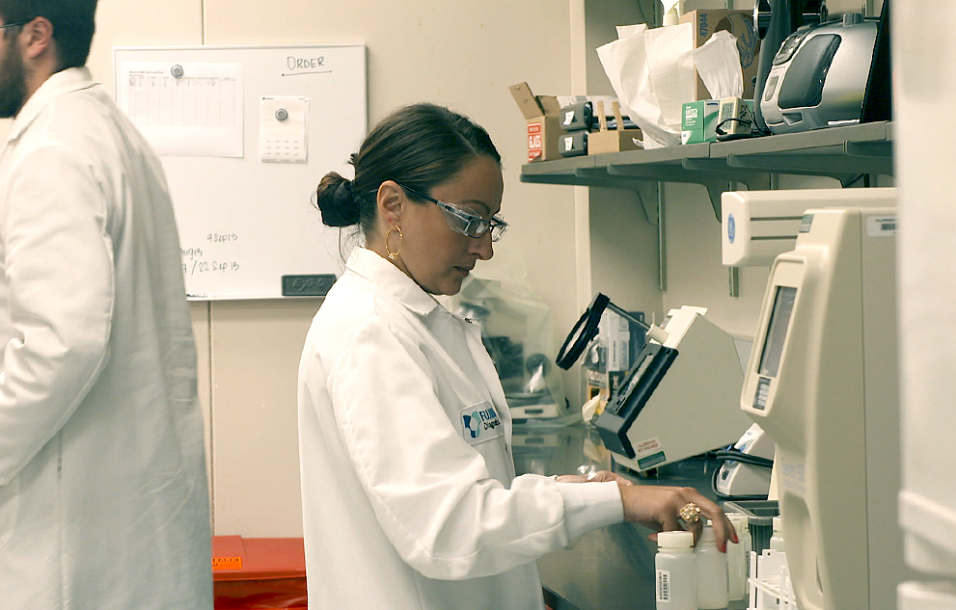
Fujirebio Diagnostics, Inc.
  Malvern, Pennsylvania
Goals
  To replace an existing paper-based GMP record system and manual process with an electronic monitoring system
Challenges
  A significant amount of time is spent each day manually reviewing reports
  The existing paper-based system was time consuming and vulnerable to reporting errors
  A new system must enable the company to remain in compliance with federal regulation
Results
  The company’s Electronic Initiative helps produce 75 million tests that are distributed throughout the world
  The solution is completely paperless and provides electronic record collection with electronic signatures while maintaining 21 CFR compliance and ISO 9001 and 13485 certification
  The equipment monitoring system saves about 1,100 man hours per year
  The tasks related to manually logging equipment parameters and reviewing paper logs and charts is eliminated and has reduced data reviewing time from 15+ hours to just minutes
  Electronic monitoring saves 2/3 of time, or about 10 hours per month in quality assurance
Industry: Life Sciences
Products: AVEVA System Platform | AVEVA Work Tasks | AVEVA Historian | InTouch HMI
“The largest benefit of the equipment monitoring system is that we are logging automatically now rather than manually, so it’s saving us about 1,100 man hours per year.”
Josh Zimmer, Quality Engineer, Fujirebio Diagnostics, Inc

Slide 25
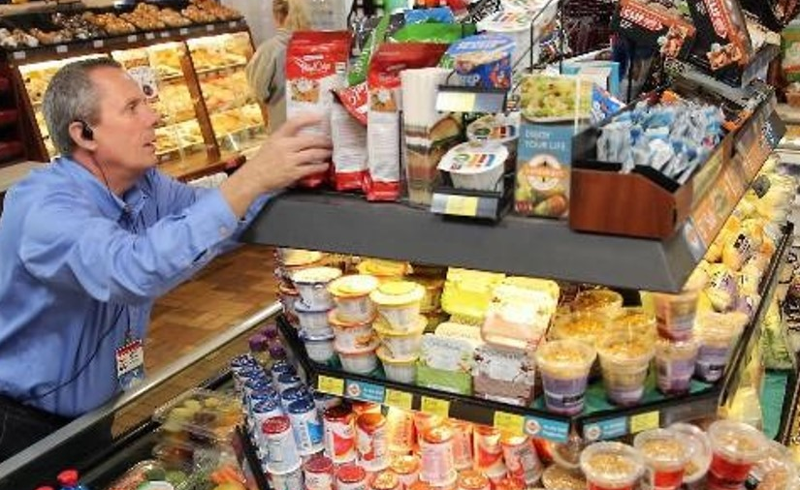
Kwik Trip
  La Crosse, Wisconsin
Goals
  Replacement of home-grown and separate systems with a Manufacturing Execution System (MES) for material receiving, labelling and for logging all material consumption and production on the shop floor in real-time.
  Complement the company's ERP system with full product genealogy (track and trace), rules of quality control procedures and for managing the shelf life of received materials..Challenges
Increase workforce efficiency through mobile solutions for material receiving, labelling and material consumption
  Challenges
  Food Safety Modernisation Act (FSMA) track & trace requirements/state & federal regulations
  Paper records used for product genealogy and risk of human error
  Difficulties to promote best practices and maintain consistency between plants
  Results
FSMA support, genealogy tracking/material traceability down from 2.5 hours to 10 minutes
Increased reporting and inventory management accuracy
Procedures are executed as electronic workflows which enforces the standard procedures for quality checks and facilitates the use of mobile devices on the shop floor
Industry: Food & Beverage / CPG
Products: AVEVA Manufacturing Execution System | AVEVA Work Tasks | AVEVA System Platform | AVEVA Historian
AVEVA supports Kwik Trip with a fully mobile, model- driven MES solution for workforce enablement, quality, traceability and regulator compliance
LEARN MORE

